Slide 1
Connecting Data with Domain Knowledge in Neural Networks -- Use Deep learning in Conventional problems
Lizhong Zheng

Slide 2
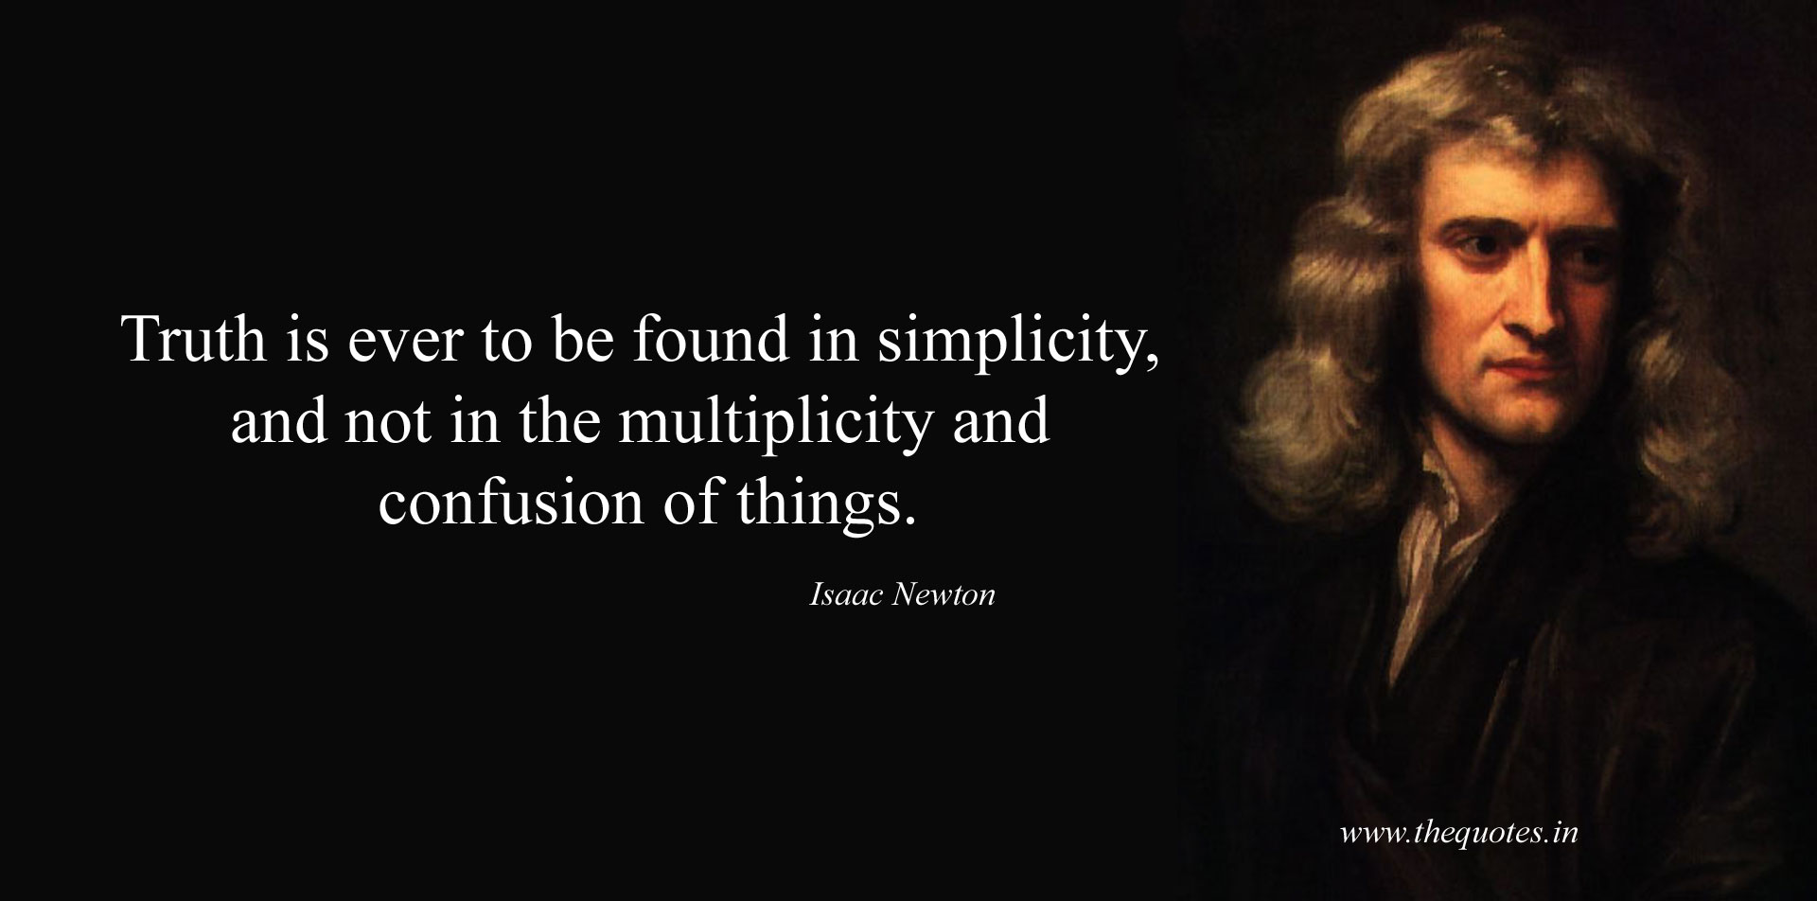
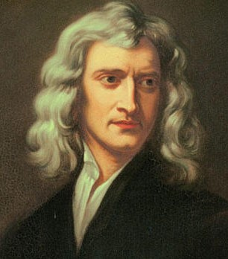
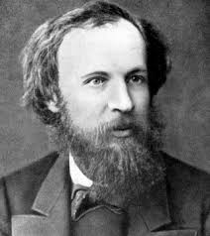
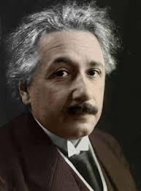
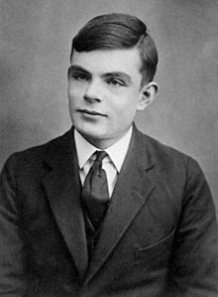
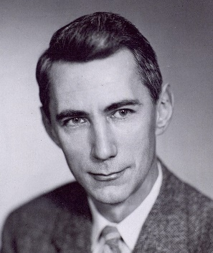
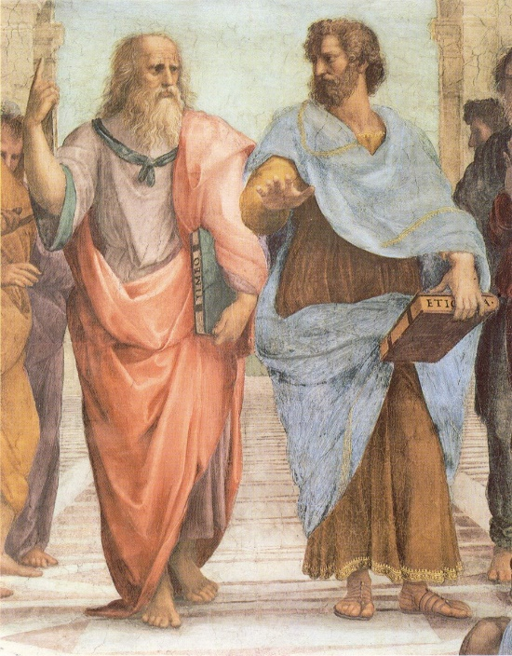
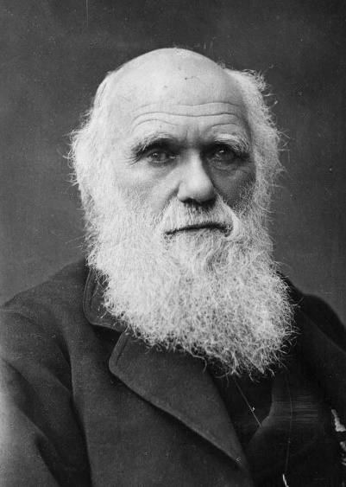
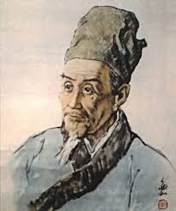

The so-called “Scientific Approach”

Slide 3
Why We Should NOT Use NN for Physical-Layer Communication Problems
Clearly defined models
Since we design it
Performance limits and optimality guarantees
Intuition, insights to guide designs
Minimum resource
Robustness, generalization, reusable solutions
Not based on models
Avoid separations
Empirical performance that is good enough
Research = Development
Fast growing computation and data acquisition
Start to see the problems
And why we really should do that

Slide 4
Let Newton Help us to Design NN
What problem we try to solve?
Which design decision comes from assumptions, which from logic?
What are the intermediate outcomes?
How resources are used?
How well are we doing? Is there alternatives?
Does it bring any new concepts?

Slide 5
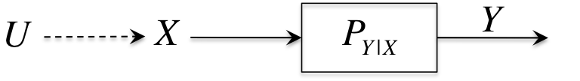
A Detection Problem
Think of X and Y both from rather large alphabets, but U is a binary valued attribute
Sometimes we would like to detect U from observations of X, sometimes from Y
Suppose we observe n i.i.d. samples for the same value of U

Slide 6
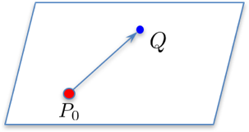
Empirical Distribution
All the information we get is in the empirical distribution
Assume in a small neighborhood:
Difference:
LLR:
Information Vector:

Slide 7
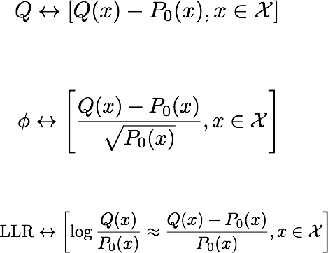
One Vector, Three Meanings
Distribution space
Information Vector
Functional Space

Slide 8
The Norm
Suppose P and Q are two distributions both in the neighborhood
Let the corresponding vector form be
Squared norm of information vector = volume of information (bits)

Slide 9
The Inner Product
Evaluating the empirical average of a feature function
Which element of the information do we want?

Slide 10
Relevance
Each simply query is a vector
Binary decision: LLR function
Scalar parameter estimation: natural statistic
Sufficient Statistics
If we choose a feature function different from the sufficient statistic, relevance measured by the inner product
Shannon chose to ignore the “Semantic aspect”, to simplify the communication problem

Slide 11
Back to the Inference Problem
Observation
Observation
Can and should use sufficient statistic when we have the full model.
The Newton-side of the story

Slide 12
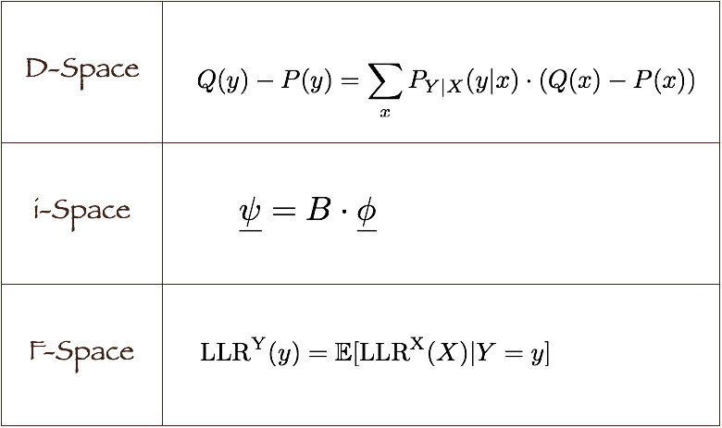
Pay Attention to the Linear Map B
Dependence between X, Y
-- in terms of info. vectors

Slide 13
What if we don’t know what is the attribute of interest?
Processing data to serve multiple purposes
Dimension reduction without model
Refuse to have preference between possible simple queries (assume all elements are equally important)
Most of lossy data processing have this flavor
Universal Feature Selection

Slide 14
The Solution:
B
Choose feature functions along the dominating singular vectors of B
Low rank approximation of B

Slide 15
Theorem:
Let be the error exponent of detecting attribute U from statistic
Average performance over rotational invariant ensemble (RIE)
The universally optimal feature function
are the SVD solutions:

Slide 16
Problem with Same Solutions (I)
Renyi (HGR) maximal correlation:
SVD solutions
Decompose dependence into modes

Slide 17
Problem with Same Solutions (II)
Extract information with k-dimensional scores
The most information (generically) features
Decompose mutual information, common information into modes and pick the stronger modes

Slide 18
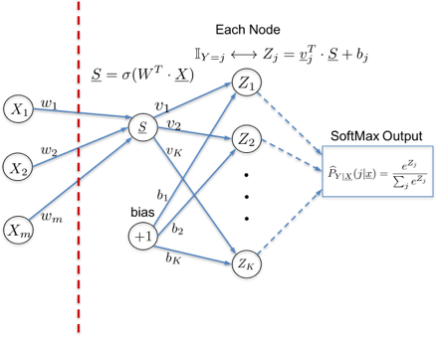
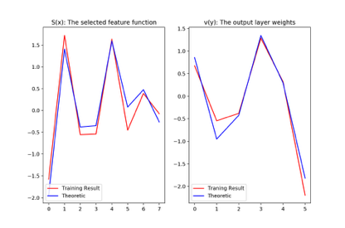
Problem with Same Solutions (III)
What should neural networks do?
Hidden layer outputs S(x): selected feature functions
Output layer weights v(y): selected function of Y to correlate with S(x)
How did NN compute SVD?
Fix S(x):
Fix v(y):

Slide 19
More Problems with Same Solutions
Many machine learning algorithms:
PCA, ICA, Oja’s rule
CCA
Correspondence analysis
Deep CCA
Low rank matrix completion
Compressed sensing, recommendation systems
Word2Vec, embedding
The first thing one can learn from data
What are we optimizing vs. How do we optimize it

Slide 20
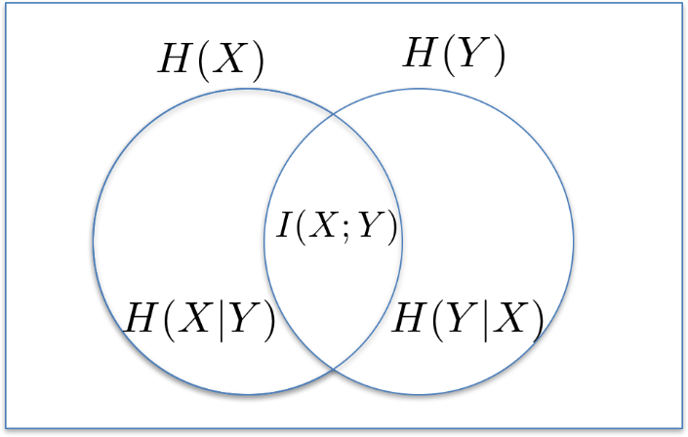
What did Newton Buy Us?
B
Information in Y about X
Everything about X
Generic information vs. specific information
Semantics and Shannon’s simplification
Avoid repetition
Decision without a full model
Performance metric and optimality
Sharp target (constraint) vs. Preferred target (regulation)

Slide 21
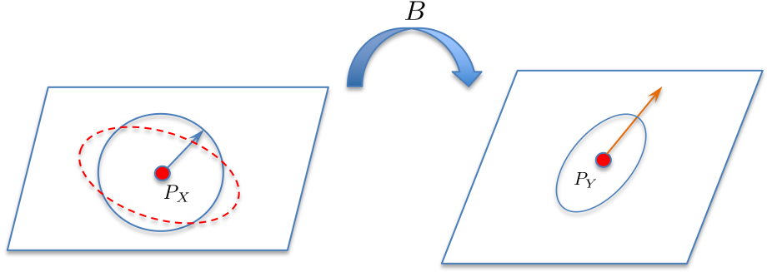
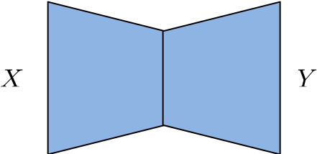
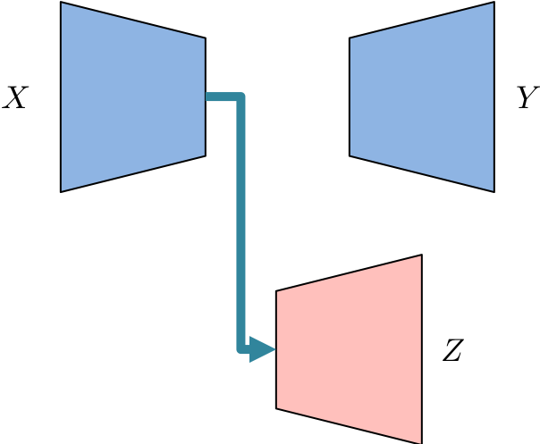
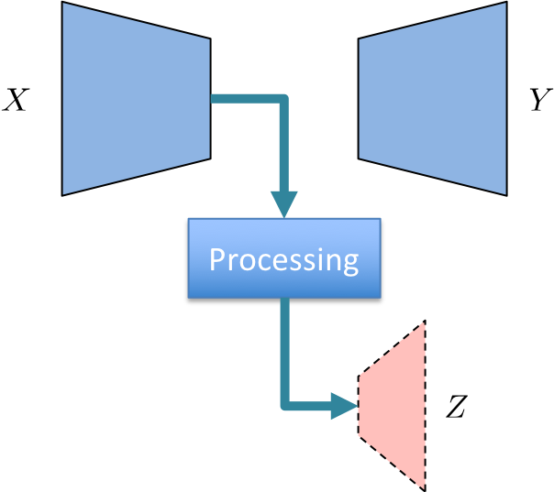
Build Neural Networks with Newton
B
Regulator, polling, other loss functions all as the result of preference in the queries.
Transfer knowledge:
Use pattern and symmetry
Select and preprocessing
More general structure, more variety of prior/domain knowledge
Multiple modality
Regularity / integer programming
Choose hyper-parameters with performance metric

Slide 22
Where would the next big step in data science be made? and How?

